Slide 1
ICRH-Europe
Website

Slide 2
Homepage
Publications
Books
Reports
Events
Upcoming
Summary of ICRH-Europe. Includes sponsors/partners.
Level 1
Level 2
Research
Articles
Past
Global Excellence Study
Organisational Resilience
About
icrh-europe.com

Slide 3



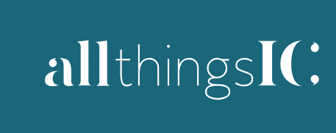
Home page
Image
Menu
Publications
Events
Research
About
Who we are
What we do
Wider ICRH Community
Supporters
Video
Valuing Internal Communication Report Download

Slide 4
Publications
Books
Journal Articles
Industry Reports
2026
Titles, author info, link to publisher page about the book
2026
Titles, author info, summary of key findings, link to journal page for the article
Titles, institute/agency info, link to report download page
2026
2025
2025
2025
2024
2024
2024

Slide 5
Events
Upcoming
Past
Webinar 1: info and registration link
Webinar 2: info and registration link
Webinar 3:info and registration link
Webinar 1: title and replay
Webinar 2: title and replay
Webinar 3: title and replay
Webinar 4: title and replay
Webinar 5: title and replay
Webinar 6: title and replay
Webinar 7: title and replay
Webinar 8: title and replay

Slide 6
Research
Global Excellence Study
Organisational Resilience
About the research programme
Research leader names and profiles
Research Aims and Objectives
Download for EUPRERA paper
Research schedule

Slide 7
About
Membership info
Current member profiles (in alphabetical order)

